Slide 1

Data Wrangling
Eng \ Mahmoud Elhemaly

Slide 2
Outlines
We’ll cover the following topics in this Session :
1. Data Wrangling Theory :
Data exploration (Discovery)
Finding Missing Values (Structuring)
Filtering Data (Cleaning)
Sorting
Merge & concatenation(Enriching)
2. Practice

Slide 3
Data Wrangling
Data Wrangling is the process of processing data, like merging, grouping and concatenating etc.
The Pandas library provides useful functions to support Data Wrangling tasks.
Data Science involves the processing of data so that the data can work well with the data algorithms.

Slide 4
Data Wrangling
So if you ask any data analysts, data scientists, or statisticians about which task they spend most of their time on, the answers will be data cleaning or data wrangling and data munging, and not coding or running a model that uses the data.

Slide 5
Benefits of data wrangling?
Simple analysis: Business analysts and stakeholders may examine even the most complex data quickly, efficiently, and effectively once raw data has been tamed and converted.
Data handling: The procedure turns raw, unstructured data into rows and columns. The technique enriches the data to gain a deeper understanding.
Improved targeting: Combining data from several sources helps you better understand your audience, which improves the targeting of your ad campaigns and content strategy.
Use of time: The technique allows analysts to spend less time managing disordered data and more time acquiring insights to make accurate decisions based on simple-to-understand data.
Data visualization: The data may be exported to any visual analytics platform to sorting, analyze, and summarize the data once it has been wrangled.

Slide 6
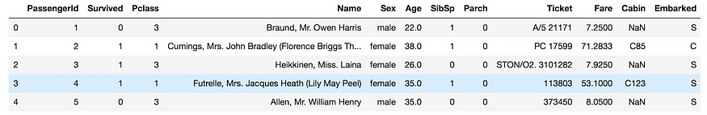
Data Exploration
The first step before doing anything with data is to locate the file (csv, excel and xlsx etc.) in the directory you’re working on and then read it through the built-in Pandas functions.

Slide 7
Dealing with missing values
Your dataset may consist of a lot of missing and duplicate values, so it's our (Data Scientist) responsibility to deal with them before applying any machine learning algorithms on them.
If we provide as much clean and accurate data as possible to our machine learning model then our trained model predicts as much accurate prediction.

Slide 8
Filtering Data
The following piece of code filters the entire dataset for age greater than 40, meaning it will consist of only those rows whose column age is greater than 40.

Slide 9
Sorting
The sort_values function helps you to sort your dataframe either in ascending or ascending order.
By default sort_values function uses quick sort algorithm for sorting and if you want to use heap sort or merge sort etc.
then you can use kind keyword.

Slide 10
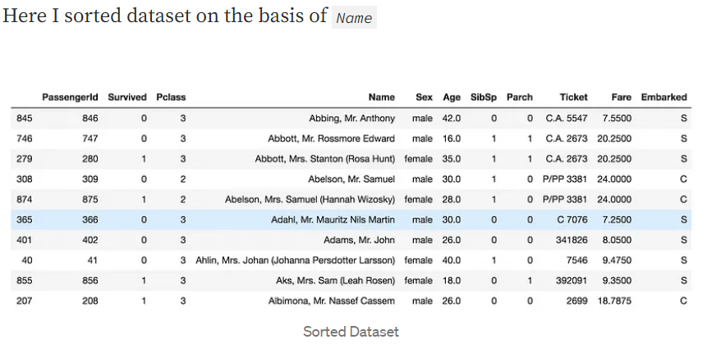
Sorting

Slide 11
Merge and Concatenation
Pandas has merge function to combine two dataframes, it’s quite a straightforward function. I have taken the top two rows and bottom two rows from the dataset and combine them by Pandas merge function.
head() and tail() functions return the top and bottom rows respectively whereas outer helps combining the two uncommon rows.

Slide 12
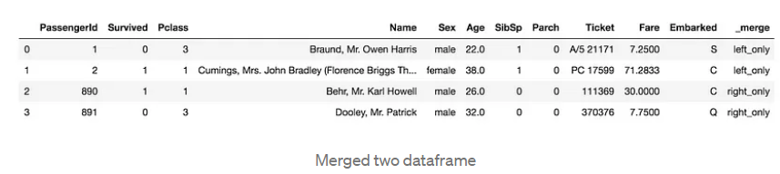
Merge and Concatenation

Slide 13
Conclusion
Examples of data wrangling:
Combining data sources for analysis.
Filling or removing data gaps.
Deleting unnecessary or irrelevant project data.
Identifying data outliers and explaining or deleting them to allow analysis.

Slide 14
Data Wrangling Goals:
Gathering data from numerous sources to reveal a more profound intelligence.
Reduce the time spent cProvide actionable and accurate data in the hands of business/data analysts in a timely matter.
ollecting and organising. In short, cleaning unruly data before it can be used.
Enable data analysts and scientists to focus on the analysis of data, not the wrangling part.
Help senior leaders in an organisation to make better decisions.

Slide 15


Questions ?!

